Slide 1
Physics Tutorial 3
Analysing Like a Physicist

Slide 2



Introduction
Self-Study Recap
Importance of Uncertainties
Mars Rovers
Reflection

Slide 3
Introduction

Slide 4
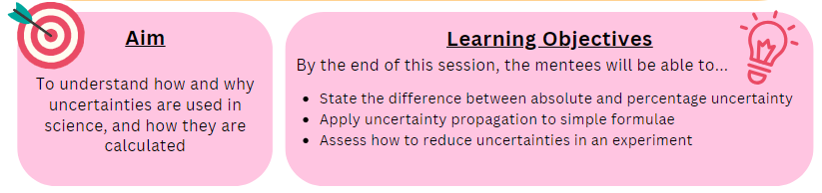
Aims and Learning Objectives

Slide 5
Ground Rules Reminder
You will need to attempt the home learning before the tutorial for the course to be effective.
Try to find a quiet space where you will not be interrupted, and spend at least 30 minutes on these problems. They could take up to an hour.
We do not expect you to always be able to answer every question in the home-learning, or during the tutorial. Being a good physicist is not about being able to answer everything straight away! We do want you to think about why you are getting stuck, and which questions you need to ask to help you develop your physics skills.
We would like you to attempt every question and record all your working and assumptions, even if you do not get a final answer.
Please arrive on time to the tutorials (aim to be a couple of minutes early if possible) and have the following materials with you:
  answers electronically or written down
  pen and paper
  a scientific calculator
Notes:
If needed

Slide 6
Self-Study Recap

Slide 7
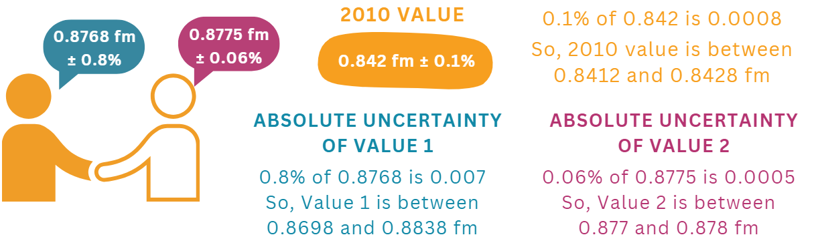
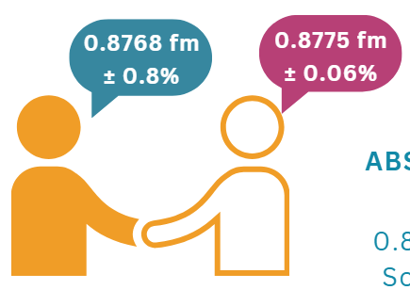
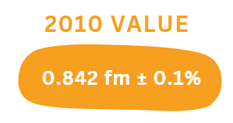
Task 1: Radius of a Proton (Prove it!)
We know that:
The 2010 value range doesn’t overlap with the other two ranges, so they don’t agree!

Slide 8
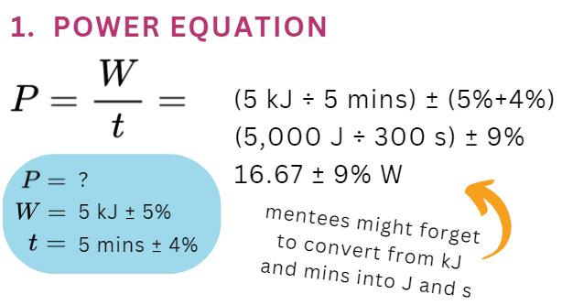
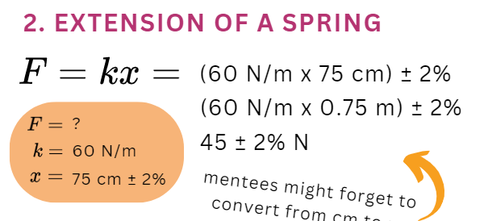
Task 2: Propagation Practice

Slide 9
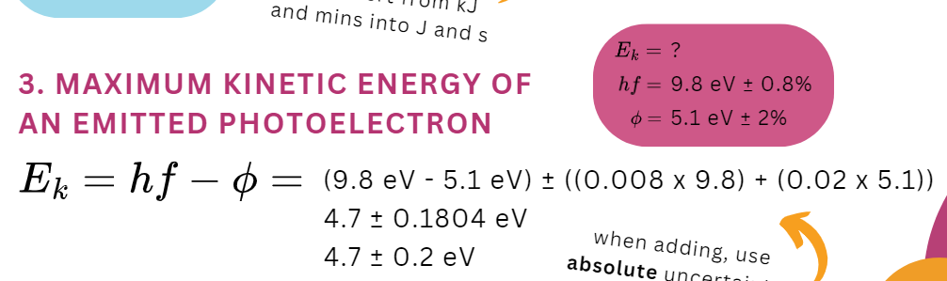
Task 2: Propagation Practice

Slide 10
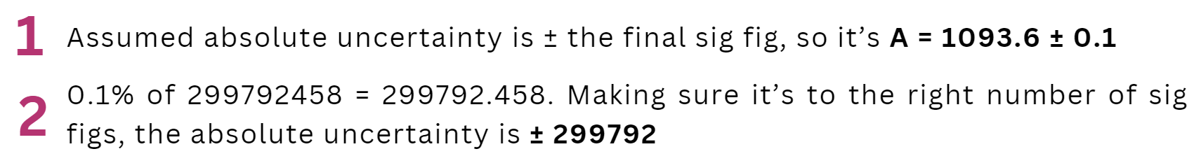
Task 3: Sig Fig Precision
Assumed absolute uncertainty is ± the final significant figure, so:
A = 1093.6 ± 0.1
0.1% of 299792458 = 299792.458. Making sure it’s to the right number of sig figs, the absolute uncertainty is:
± 299792

Slide 11
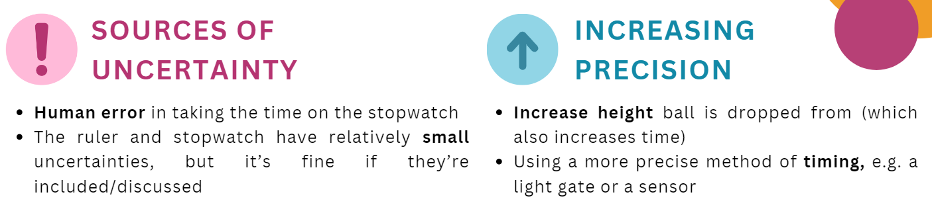
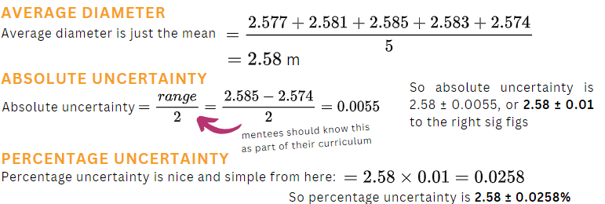
Task 4: Experiments

Slide 12
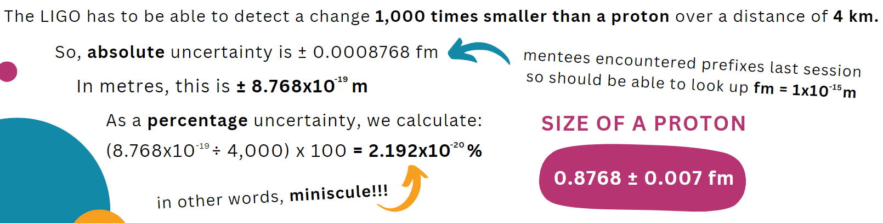
Optional Extras
Detecting Gravitational Waves

Slide 13
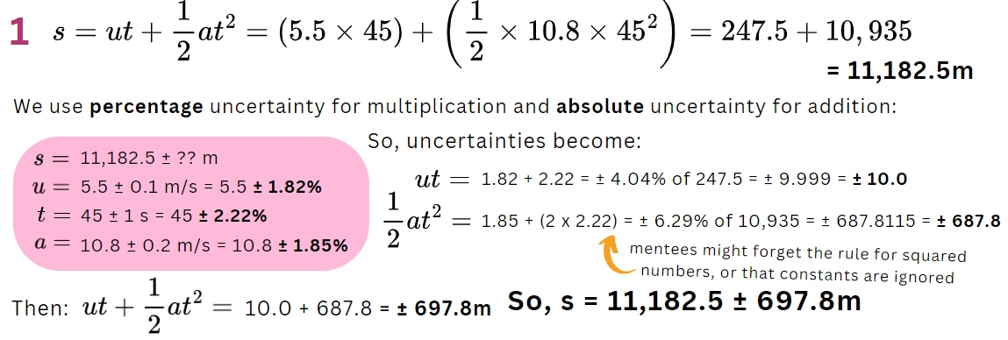
Optional Extras
Harder Uncertainty Calculations

Slide 14
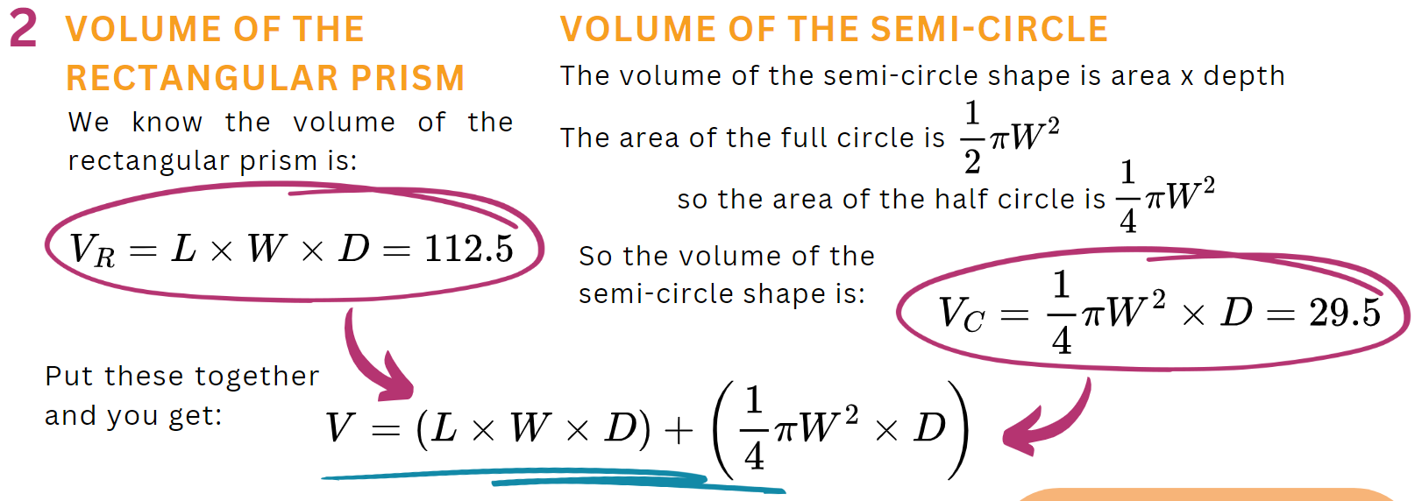
Optional Extras
Harder Uncertainty Calculations

Slide 15
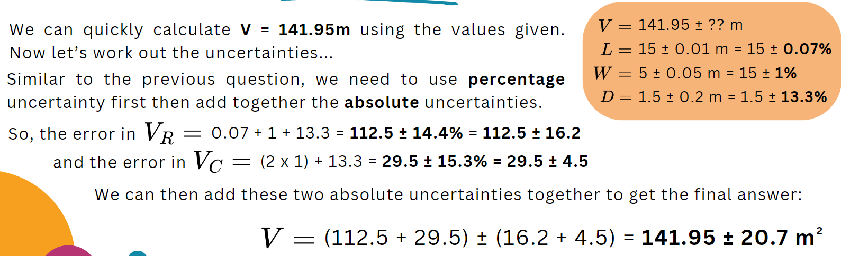
Optional Extras
Harder Uncertainty Calculations

Slide 16


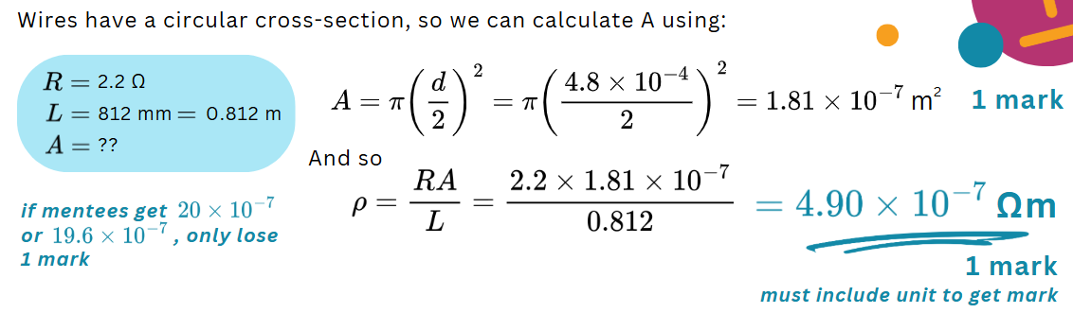
Exam Practice

Slide 17

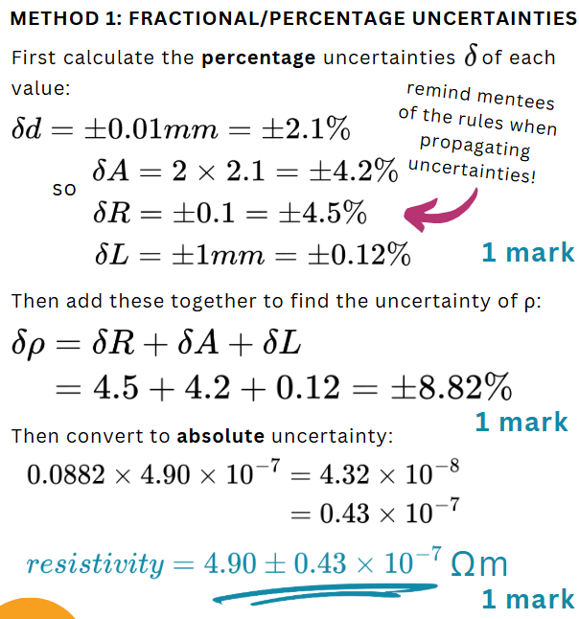
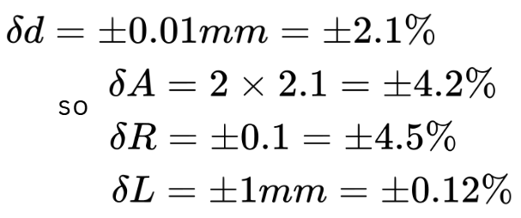
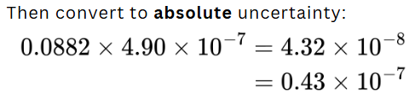
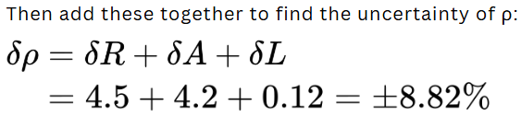

Exam Practice

Slide 18


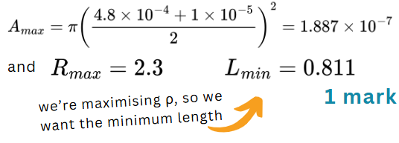
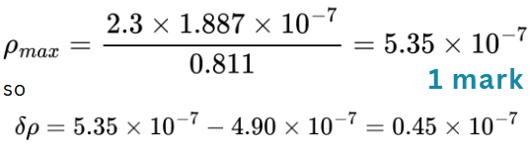

Exam Practice

Slide 19

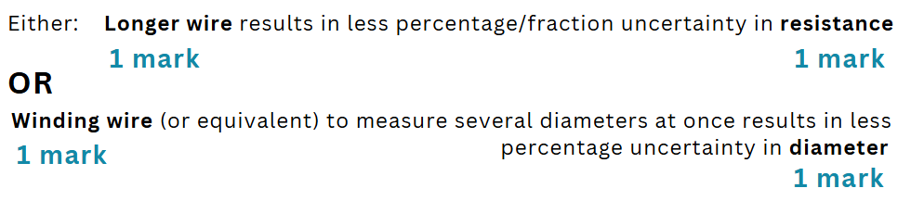
Exam Practice

Slide 20

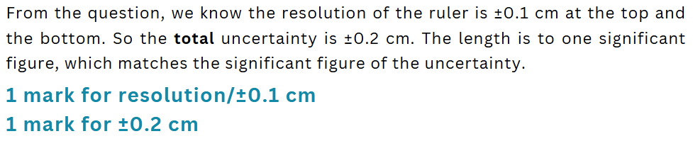
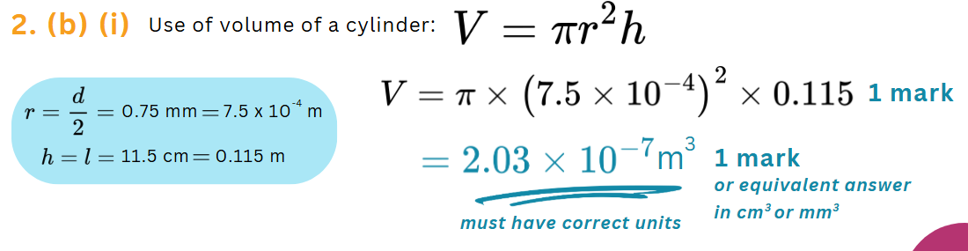
Exam Practice

Slide 21



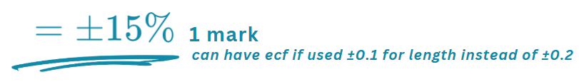
Exam Practice

Slide 22
Importance of Uncertainties

Slide 23

What’s the Difference?
What do you think the difference is between uncertainty and error?
Can you write a definition for each one?

Slide 24


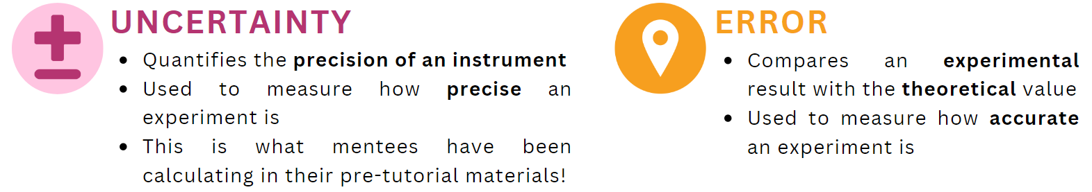
Uncertainty and Error

Slide 25
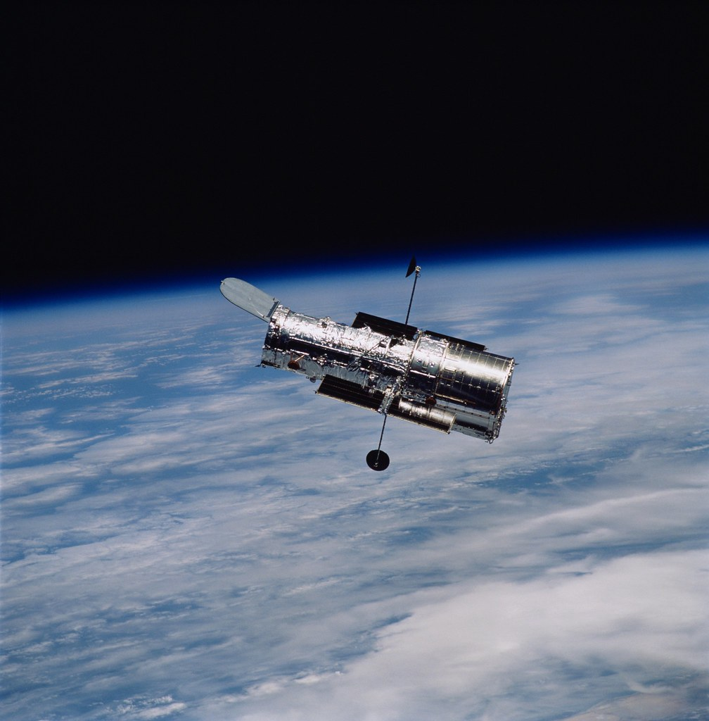
Effect of Uncertainty
When the Hubble telescope was sent into space in 1990, the images weren’t as sharp as expected
The mirror had been ground too flat because they got the percentage error wrong!
  By 1/50th of a human hair
They had to solve the problem by doing several space walks in 1993
https://www.bbc.co.uk/videos/cd1p0z05103o

Slide 26
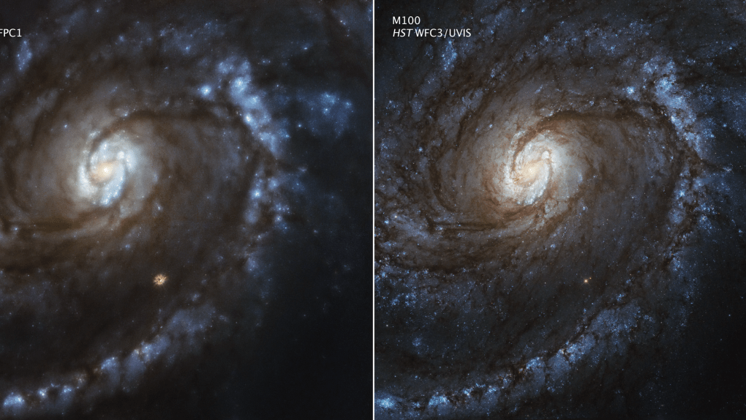

Slide 27
Mars Rovers
Notes:
Use the following slides to write mentee questions and quiz them on it

Slide 28
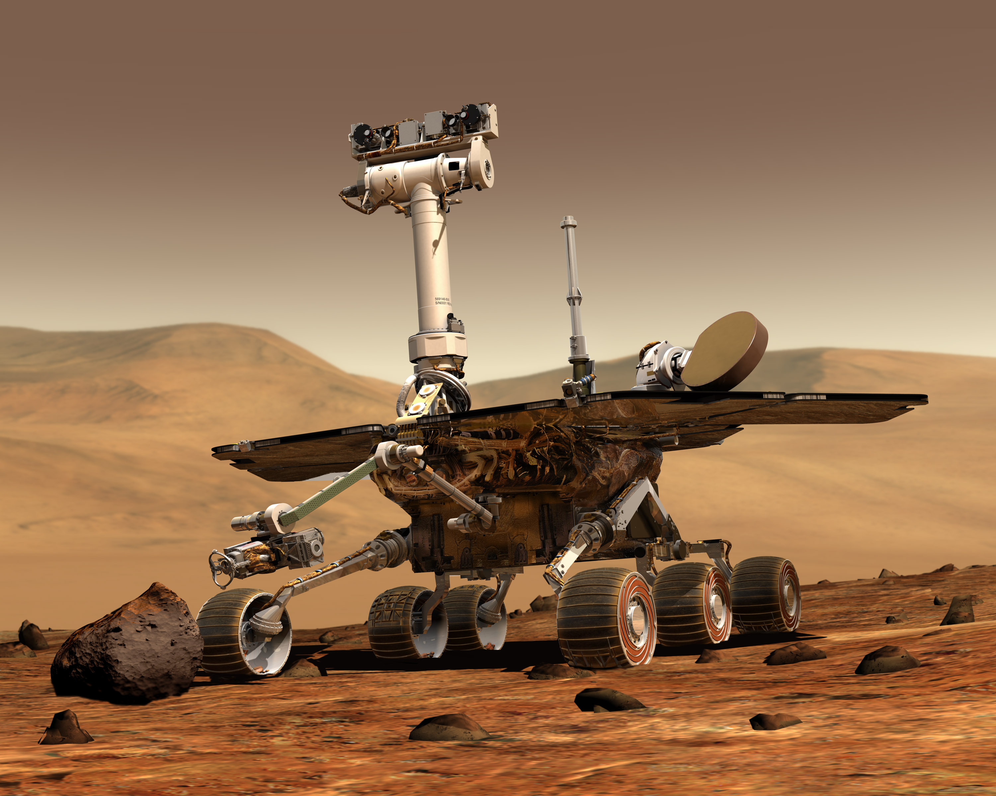
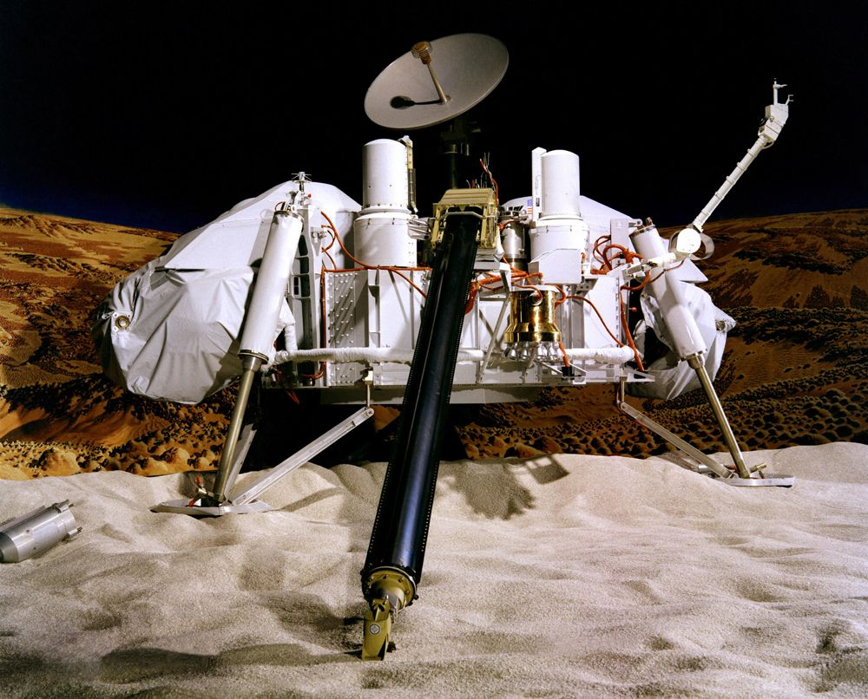
Viking vs. Curiosity
https://youtu.be/hRAFPdDppzs?si=dYM5y_KwSgLc2vfi&t=163

Slide 29
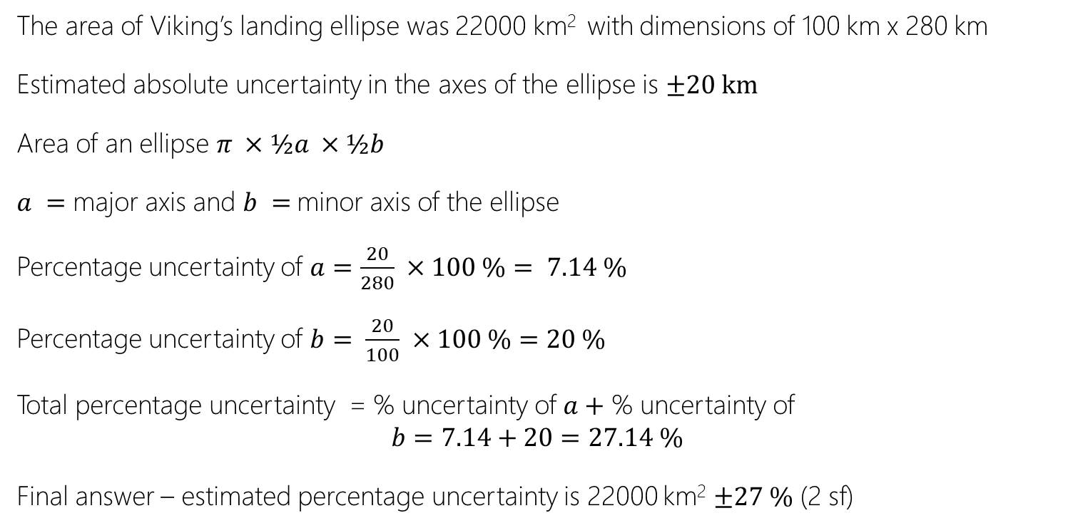
Calculating Landing Uncertainty
Viking Rover
The area of Viking’s landing ellipse was 22000 km² with dimensions of 100 km x 280 km
Estimated absolute uncertainty in the axes of the ellipse is $±20 km$
Area of an ellipse $π ×½a ×½b$
$a =$ major axis and $b =$minor axis of the ellipse
Percentage uncertainty of $a=\frac{20}{280} ×100 \%= 7.14 \%$
Percentage uncertainty of $b= \frac{20}{100} ×100 \%=20 \%$
Total percentage uncertainty = % uncertainty of $a+$ % uncertainty of
$$b=7.14+20=27.14 \%$$
Final answer – estimated percentage uncertainty is 22000 km² $±27 \%$ (2 sf)

Slide 30
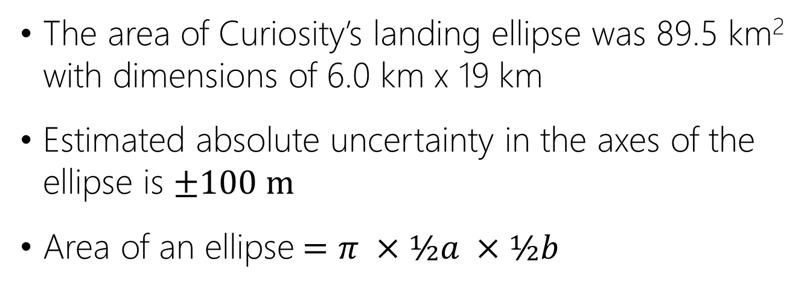
Calculating Landing Uncertainty
Curiosity Rover
The area of Curiosity’s landing ellipse was 89.5 km² with dimensions of 6.0 km x 19 km
Estimated absolute uncertainty in the axes of the ellipse is $±100 m$
Area of an ellipse$=π ×½a ×½b$
Calculate the percentage uncertainty for the Curiosity!

Slide 31
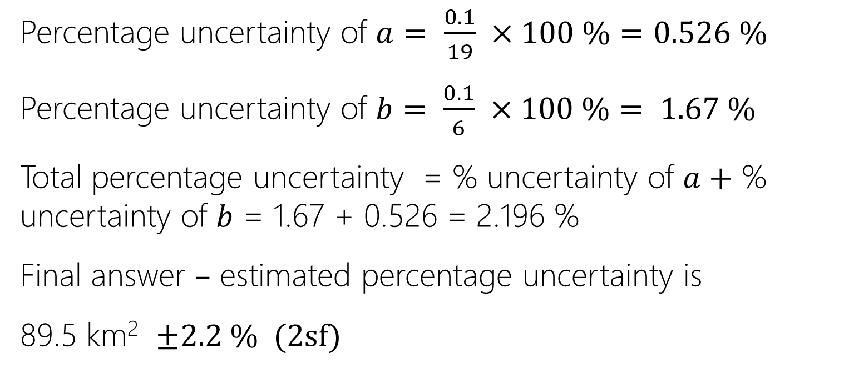
Calculating Landing Uncertainty
Curiosity Rover
Percentage uncertainty of $a= \frac{0.1}{19} ×100 \%=0.526 \%$
Percentage uncertainty of $b= \frac{0.1}{6} ×100 \%= 1.67 \%$
Total percentage uncertainty = % uncertainty of $a+$ % uncertainty of $b$ = 1.67 + 0.526 = 2.196 %
Final answer $–$ estimated percentage uncertainty is
89.5 km² $±2.2 \% (2sf)$

Slide 32
Viking vs. Curiosity
The Gale Crater has an area of approximately 75000 km²
Why was the Gale Crater not a suitable choice for the Viking to land in?

Slide 33

Questions?

