Slide 1
Physics Tutorial 2
Performing Like a Physicist

Slide 2
Introduction
Self-Study Recap
Who Wants to Be a Millionaire?
Quiz Time!
Reflection

Slide 3
Introduction

Slide 4
Aims and Learning Objectives

Slide 5
Ground Rules Reminder
You will need to attempt the home learning before the tutorial for the course to be effective.
Try to find a quiet space where you will not be interrupted, and spend at least 30 minutes on these problems. They could take up to an hour.
We do not expect you to always be able to answer every question in the home-learning, or during the tutorial. Being a good physicist is not about being able to answer everything straight away! We do want you to think about why you are getting stuck, and which questions you need to ask to help you develop your physics skills.
We would like you to attempt every question and record all your working and assumptions, even if you do not get a final answer.
Please arrive on time to the tutorials (aim to be a couple of minutes early if possible) and have the following materials with you:
answers electronically or written down
pen and paper
a scientific calculator

Slide 6
Self-Study Recap

Slide 7
Task 1: Calculation Practice
1.
$$(3×{10}^{4})×(8×{10}^{2})$$
2.
$$\frac{(8.4×{10}^{6})}{(2.1×{10}^{2})}$$
$$=(3×8)×({10}^{4}×{10}^{2})$$
$$=24×{10}^{4+2}$$
$$=(8.4÷2.1)×({10}^{6}÷{10}^{2})$$
$$=24×{10}^{6}$$
$$=4×{10}^{6−2}$$
$$=2.4×{10}^{7}$$
$$=4×{10}^{4}$$

Slide 8
Task 1: Calculation Practice
$$(9×{10}^{2})×\frac{(5×{10}^{9})}{(2.5×{10}^{3})}$$
3.
$$=(9×{10}^{2})×\left(\left(5÷2.5\right)×\left({10}^{9}÷{10}^{3}\right)\right)$$
$=(9×{10}^{2})×(2×{10}^{6}$)
$$=(9×2)×({10}^{2}×{10}^{6})$$
$$=18×{10}^{2+6}$$
$$=18×{10}^{8}$$
$$=1.8×{10}^{9}$$

Slide 9
Task 1: Calculation Practice
$$\left(5×{10}^{6}\right)×\frac{\left(2.4×{10}^{2}\right)}{\left(1.2×{10}^{8}\right)}=10$$
Challenge Questions
4.
$$\frac{{10}^{3}×{10}^{−2}×{10}^{7}}{{10}^{−5}×{10}^{4}}={10}^{9}$$
5.
$$=(5×{10}^{6})×\left(\left(2.4÷1.2\right)×\left({10}^{2}÷{10}^{8}\right)\right)$$
$$={(10}^{3−2+7})÷({10}^{−5+4})$$
$=(5×{10}^{6})×(2×{10}^{2−8}$)
$$={10}^{8}÷{10}^{−1}$$
$$=(5×2)×({10}^{6}×{10}^{−6})$$
$$={10}^{8−−1}$$
$$=10×{10}^{6−6}$$
$$={10}^{9}$$
$$=10×{10}^{0}$$
$$=10$$

Slide 10
Task 2: Gravity
$$F=\frac{Gm_{1}m_{2}}{r^{2}}$$
$=\left(\left(6.67×{10}^{−11}\right)×\left(5.97×{10}^{24}\right)×\left(7.34×{10}^{22}\right)\right)÷\left(3.85×{10}^{8}\right)$
$=\left(\left(6.67×5.97×7.34\right)×\left({10}^{−11}×{10}^{24}×{10}^{22}\right)\right)÷\left(3.85×{10}^{8}\right)$
$$=(292.28×{10}^{35})÷(3.85×{10}^{8})$$
$$=(292.28÷3.85)×({10}^{35}÷{10}^{8})$$
$$=75.9×{10}^{27}$$
$$=7.59×{10}^{28}$$

Slide 11
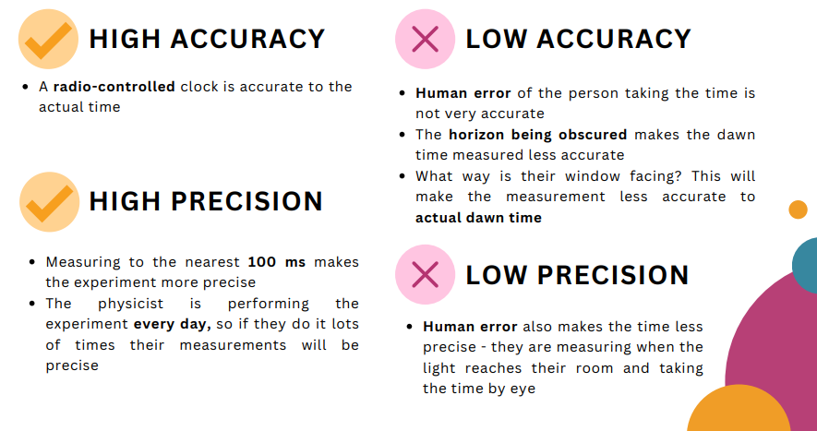
Task 3: Accuracy and Precision

Slide 12
Task 4: Recording Data
T has no units
What do T, RC, and RTh mean?
Voltage (V) | T | RC (Ω) | RTh (Ω)
6.28 | 293.2 | 227.4 | 13100
6.088 | 286.4 | 223 | 16440
5.8 | 276.7 | 217.2 | 22600
5.1 | 252.7 | 201 | 56270
5 | 249.2 | 198.9 | 64660
4.35 | 226.9 | 184.4 | 175900
4.0 | 216.9 | 177.7 | 284100
3.9119 | 211.7 | 174 | 372000
3.5 | 200.4 | 165.8 | 704000
3.0809 | 183.2 | 153.4 | 2055000
2.245 | 161.2 | 135.6 | 10600000
1.952 | 144.4 | 121.2 | 49400000
1.6 | 134.4 | 110.1 | OL
Voltage and RC are not recorded with consistent sig. figs
RTh would be better presented in standard form
What does “OL” mean?

Slide 13
Optional Extras
1.
$$E=mc^{2}$$
$$=\left(9.11×{10}^{−31}\right)×{\left(2.99×{10}^{8}\right)}^{2}$$
$$=\left(9.11×{10}^{−31}\right)×\left(2.99×{10}^{10}\right)$$
$$=(9.11×2.99)×({10}^{−31}×{10}^{10})$$
$$=27.24×{10}^{−21}$$
$$=2.72×{10}^{−20}$$

Slide 14
Optional Extras
$$E=\frac{Q}{4πε_{0}r^{2}}$$
$$=\left(3.20×{10}^{−16}\right)÷\left(4π×\left(8.85×{10}^{−12}\right)×{\left(2.4×{10}^{−9}\right)}^{2}\right)$$
2.
$$=\left(3.20×{10}^{−16}\right)÷\left(4π×\left(8.85×{10}^{−12}\right)×\left(2.4×{10}^{−18}\right)\right)$$
$$=\left(3.20×{10}^{−16}\right)÷\left(4π×\left(8.85×2.4\right)×\left({10}^{−12−18}\right)\right)$$
$$=\left(3.20×{10}^{−16}\right)÷\left(4π×\left(21.24×{10}^{−30}\right)\right)$$
$$=\left(3.20×{10}^{−16}\right)÷\left(266.91×{10}^{−30}\right)$$
$$=\left(3.20×266.91\right)×\left({10}^{−46}\right)$$
$$=0.0120×{10}^{−46}$$
$$=1.20×{10}^{−48}$$

Slide 15
Who Wants to Be a Millionaire?

Slide 16
In 2001, a man cheated his way to winning £1m:
https://www.youtube.com/watch?v=HIGtLRnGCD4
Notes:
Use to insert media

Slide 17
The million pound question…
…was about prefixes!!

Slide 18
Your Million Pound Question
Come up with your own “million pound question” about today’s topic
You can work in pairs/threes or on your own
You must create 1 question with 4 multiple-choice answers

Slide 19
Quiz Time!
Notes:
Use the following slides to write mentee questions and quiz them on it

Slide 20
1
Mentee question here
Answer 1
Answer 2
A
B
Answer 3
Answer 4
C
D

Slide 21
2
Mentee question here
Answer 1
Answer 2
A
B
Answer 3
Answer 4
C
D
Notes:
Use to insert media

Slide 22
3
Mentee question here
Answer 1
Answer 2
A
B
Answer 3
Answer 4
C
D
Notes:
Use to insert media

Slide 23
4
Mentee question here
Answer 1
Answer 2
A
B
Answer 3
Answer 4
C
D
Notes:
Use to insert media

Slide 24
5
Mentee question here
Answer 1
Answer 2
A
B
Answer 3
Answer 4
C
D
Notes:
Use to insert media

Slide 25
6
Mentee question here
Answer 1
Answer 2
A
B
Answer 3
Answer 4
C
D
Notes:
Use to insert media

Slide 26
Answers!
Notes:
Make a note of the answers and go through them here

Slide 27
Questions?

